Slide 1
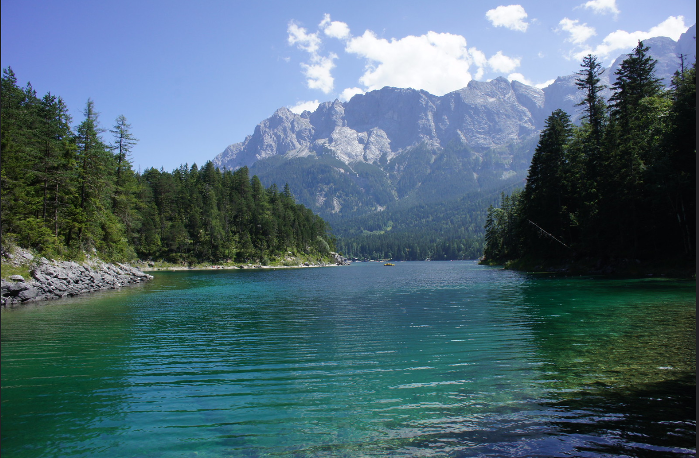
STAT450: Case Studies in Statistics
The Effects of Climate Variables on Average Stream Flow for Canadian Watersheds
Client: Asad Haris, UBC Postdoctoral Fellow
Group 2: Anjali Chauhan, Kelvin Li, Kohl Peterson, Vanessa Bayubaskoro
Lake by Barnyz CC BY-NC-NC 2.0

Slide 2
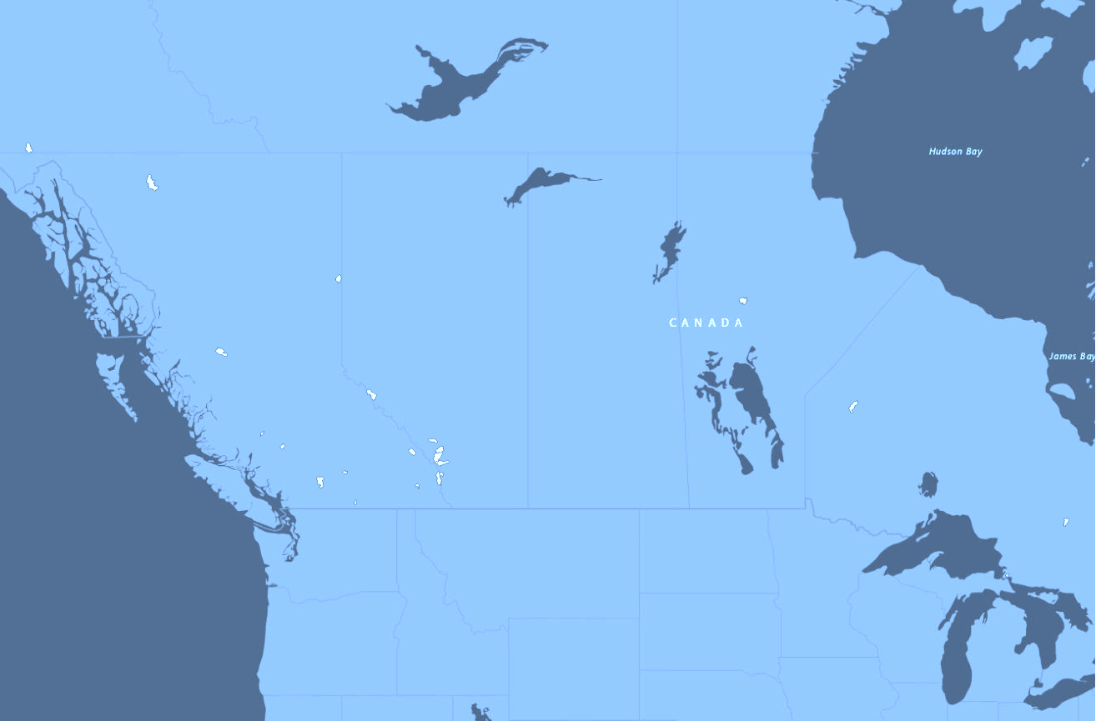
Introduction
What is a watershed?
Applications of watershed hydrology
Want to understand impact & relationship of climate variables on stream flow
Notes:
A watershed refers to an area of land where rainfall and snowmelt collect and stream into a common outlet like rivers, lakes and other bodies of water.
Understanding watershed stream flow is important for fields that manage water resources like irrigation, hydroelectric power and flood control.

Slide 3
Objectives
Find significant climate variables
Visualize the relationships between climate variables and streamflows
Predict the average stream flow from significant climate variables
Detect outliers in the average streamflow values

Slide 4
Data
23 catchment areas located around Canada
Size: 50 - 10,000 km²
Historical data from 1980 - 2018
61 unknown mean streamflow values
9 climate variables of interest
Notes:
What one thing do you want audience to remember, per slide?
In this study, there is data available for 23 medium-sized water catchment areas located around Canada. The size of these watershed areas ranges from 50 km2 to 10,000 km2 . The data of various climate variables were taken from the year 1980 to 2018. This data was measured daily by satellites and the annual averages were calculated for this project. There is no missing data in our climate variables but there are 61 unknown mean streamflow values. There are 9 climate variables of interest and we are interested in the relationship between streamflow and these variables.

Slide 5
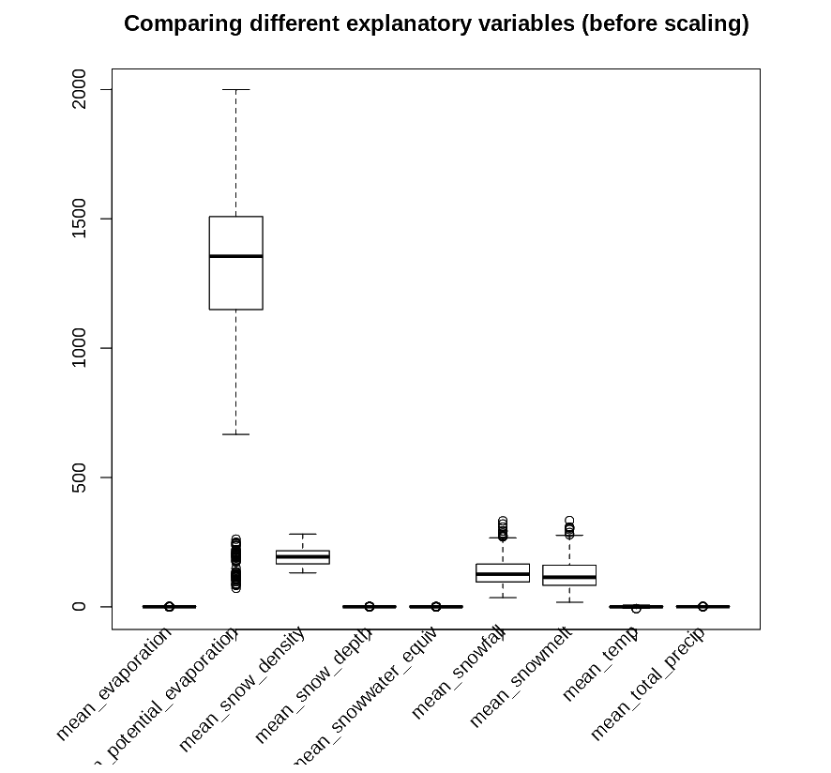
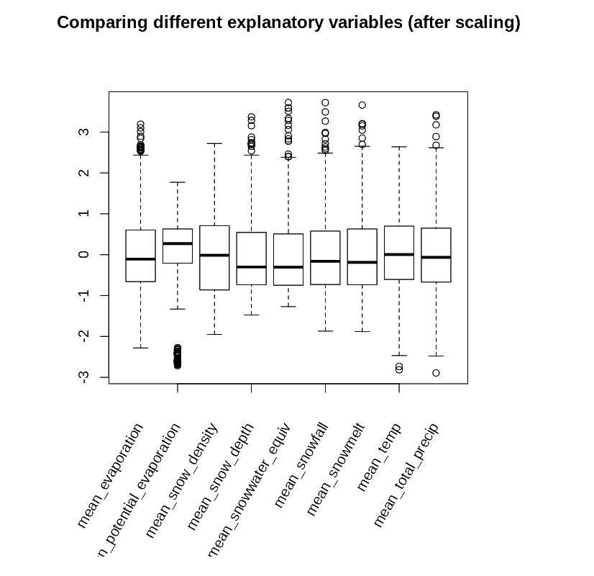
Exploratory Data Analysis
Before scaling
After scaling
Notes:
Take 1-2 aspects of your EDA
Explain its purpose relative to the objectives
Present a plot or two to illustrate your EDA
What does the plot say about your purpose?

Slide 6
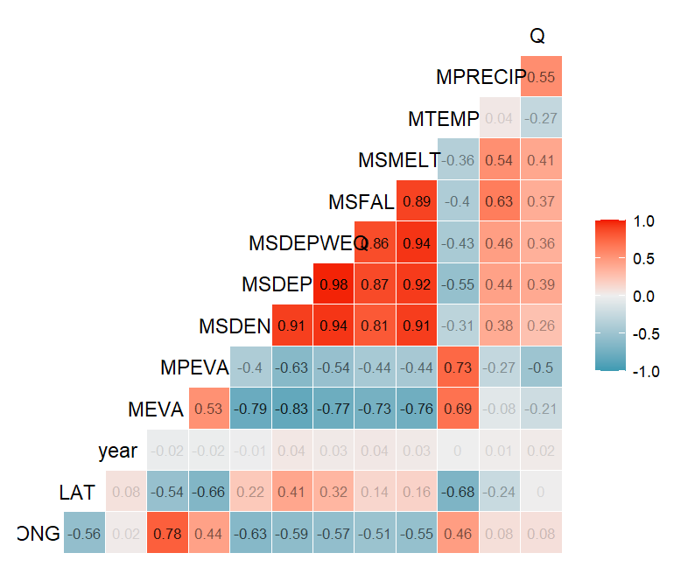
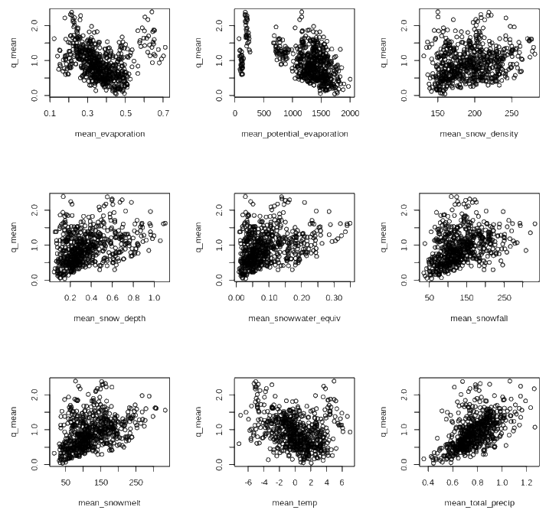
Exploratory Data Analysis
Relationship b/w explanatory variables and response
Heatmap: Correlation of explanatory variables
Notes:
Take 1-2 aspects of your EDA
Explain its purpose relative to the objectives
Present a plot or two to illustrate your EDA
What does the plot say about your purpose?

Slide 7
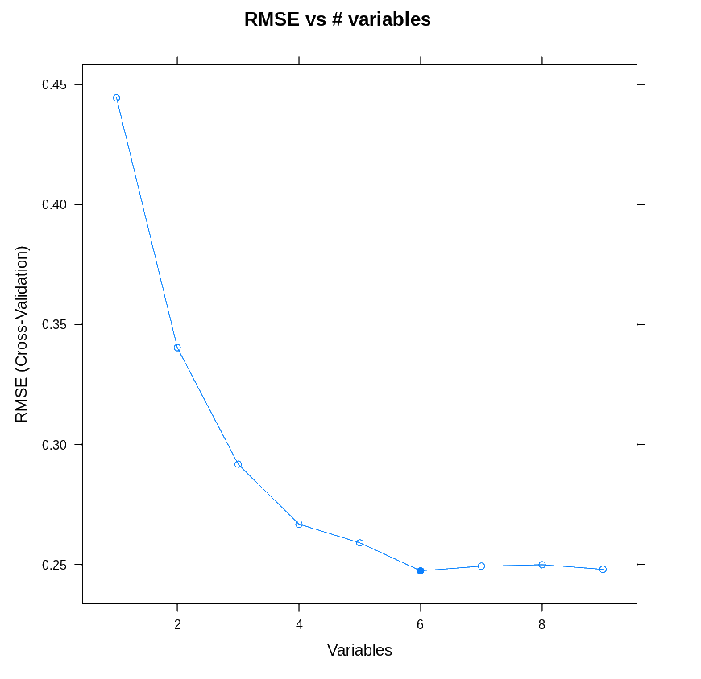
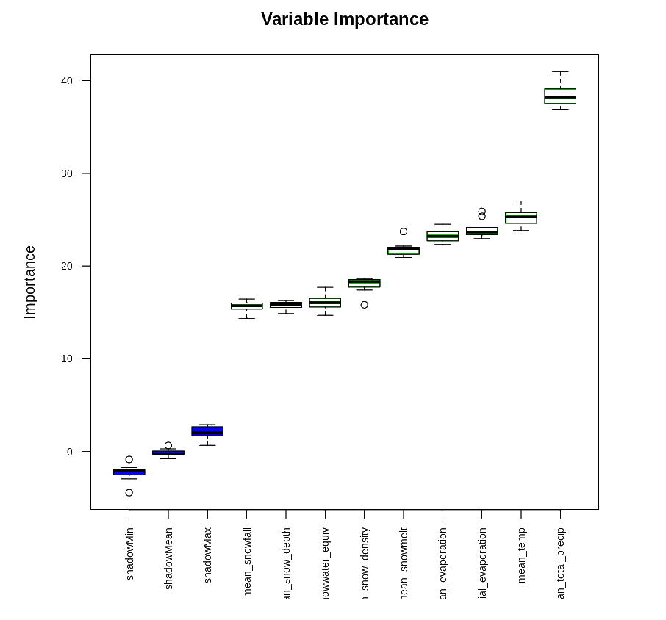
Statistical Analysis: Feature Selection
Notes:
Concentrate on one method (nice if it relates to the EDA you presented)
State the method clearly, for example:
Regress y on x, test the null hypothesis that the slope is 0
Carry out a cluster analysis using as input ….
Relate your proposed method to an objective

Slide 8
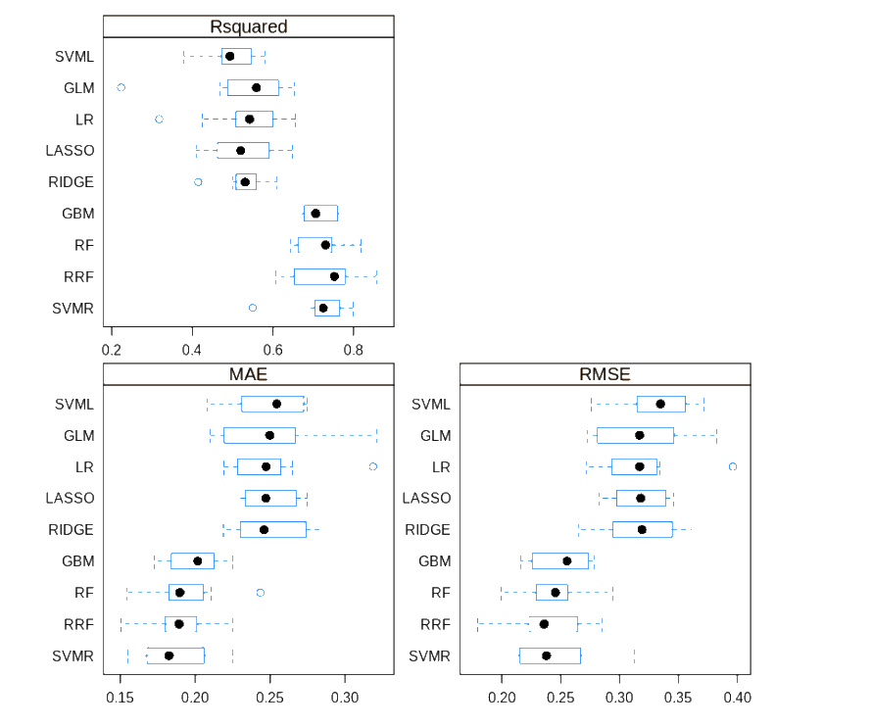
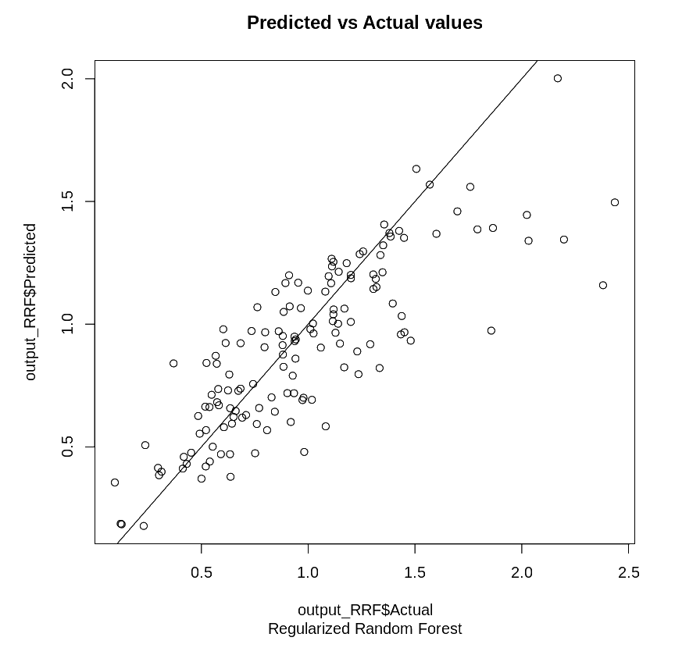
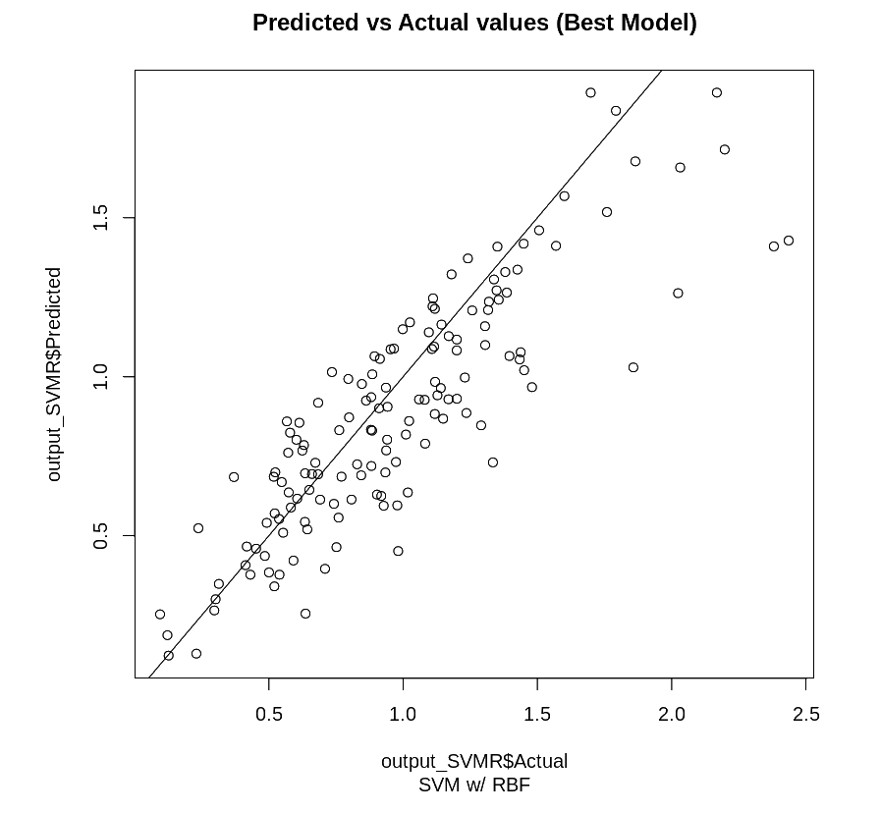
Statistical Analysis: Results
Comparison of evaluation metrics for different models

Slide 9

Future step(s)
Revise the existing feature selection pipeline and incorporate feature engineering
Perform hyperparameter tuning to improve existing model performance
Outlier Detection using tree-based models
Notes:
If the correlated variables are all worth keeping in model, we might consider using regularized models to deal multicollinearity.

